Slide 1

ACSI®, Research, and Other Updates

Slide 2
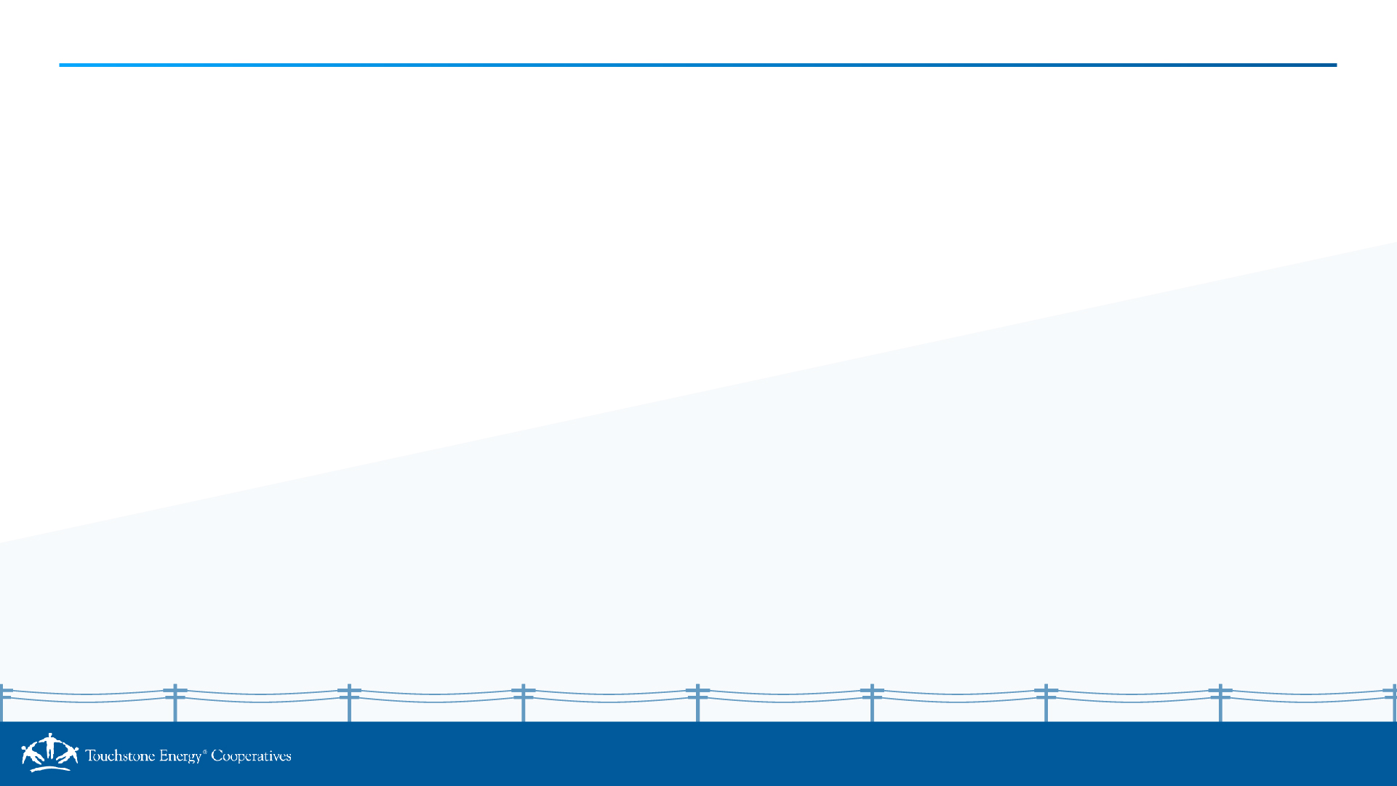
Research Schedule 2026
Time Frame | Publish | Item | Objective | Research Partner | Data Collection Period
Q1 | March | ACSI Recap Report | Annual ACSI Trends | ACSI | 2025
Q2 | April | Broadband Internet Services | Member Perspectives | CFI Group/ACSI | February 2026
 | June | Home Buying in the Energy Transition | Sponsored Study | SECC | Completed
Q3 | August | Gen Z | Member Perspectives | CFI Group/ACSI | June 2026
 | August | Exploring Energy Affordability | Sponsored Study | SECC | April-May 2026
 | TBD | Cooperative Advantage Report | National Survey | CFI Group/ACSI | April-June 2026
 | TBD | Community Engagement | Member Perspectives | CFI Group/ACSI | August 2026
Q4 | October | Analyzing Rate Choices: Implications for Consumer Behavior | Sponsored Study | SECC | April-May 2026
 | TBD | Member Satisfaction and Engagement | Member Perspectives | CFI Group/ACSI | October 2026

Slide 3
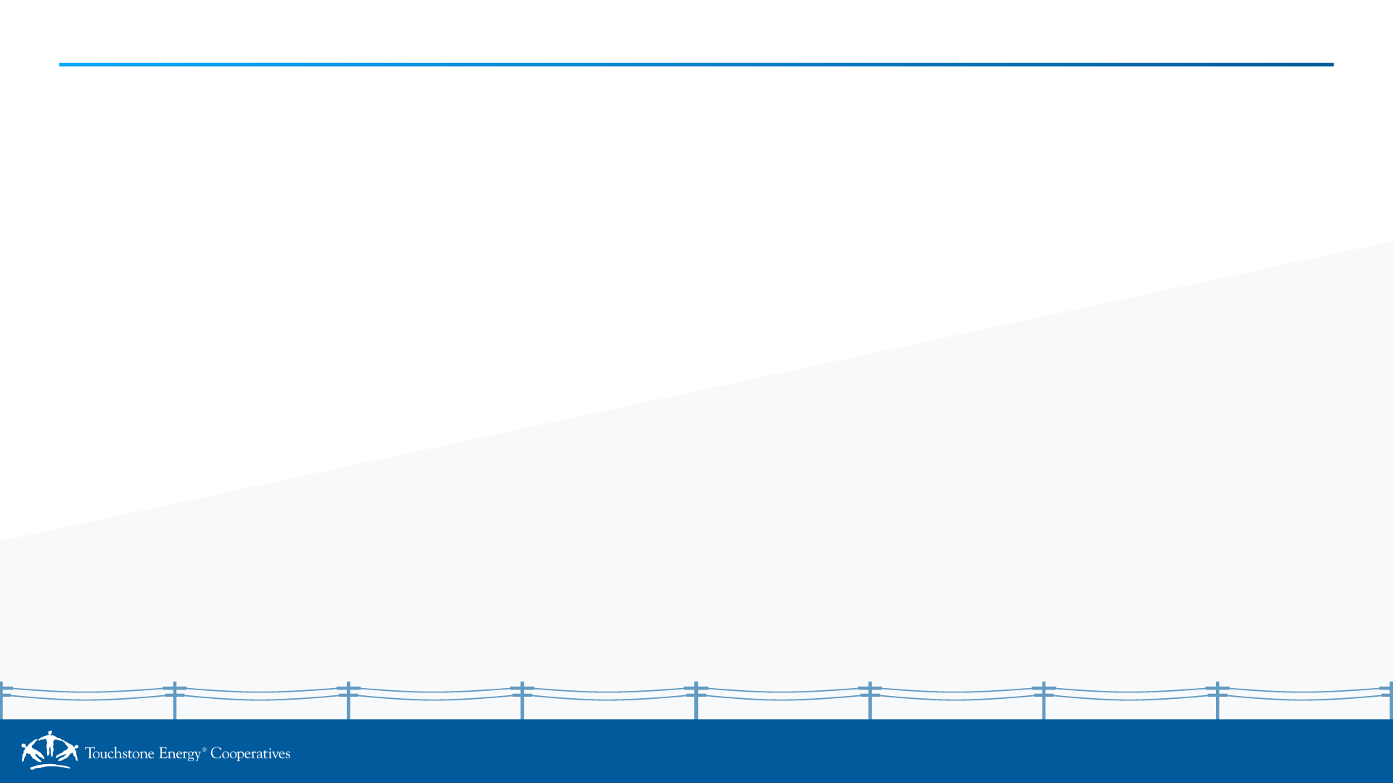
ACSI® Trends: 2026 (Jan. – June)
Between January 1 and June 30, 2026, 167 scores across over 140 co-ops were received for energy utility services.
16 new users, that is, co-ops and affiliates that have either never received an ACSI score or not since / before 2018

Slide 4
Questline Selection for Q3 (2026)
July 2026
Residential Reducing High Energy Bills in the Summer* How to Upgrade Your Cooling System* Ceiling Fans: Advanced Features to Look For Business 5 Sources of Heat Gain That May Be Costing You
August 2026
Residential Back to School Home Energy Quiz Inspector Energy: The Laundry Room List* How Much Are Your Energy-Using Devices Costing You? Business 4 Steps to Happier Customers and Lower Energy Bills*
September 2026
Residential You Can Benefit From a Home Energy Audit* Beyond the Plug: 3 Ways to Save on Electronics What Your Home is Trying to Tell You About Energy Loss* Business Business Ready: Continuity Planning*
*available for all Touchstone Energy® member cooperatives to embed content & request newsfeed on SHiNE website

Slide 5
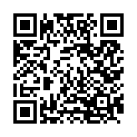
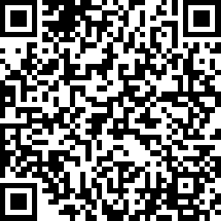
Upcoming Questline Webinars
Webinar Title | Date
Hidden Energy Costs | Tuesday, September 15, 2026 at 2pm Eastern
A Battery of Choices: Energy Storage | Tuesday, October 13, 2026 at 2pm Eastern

