Slide 1

Other Business
Committee Vacancies/Nominations

Slide 2
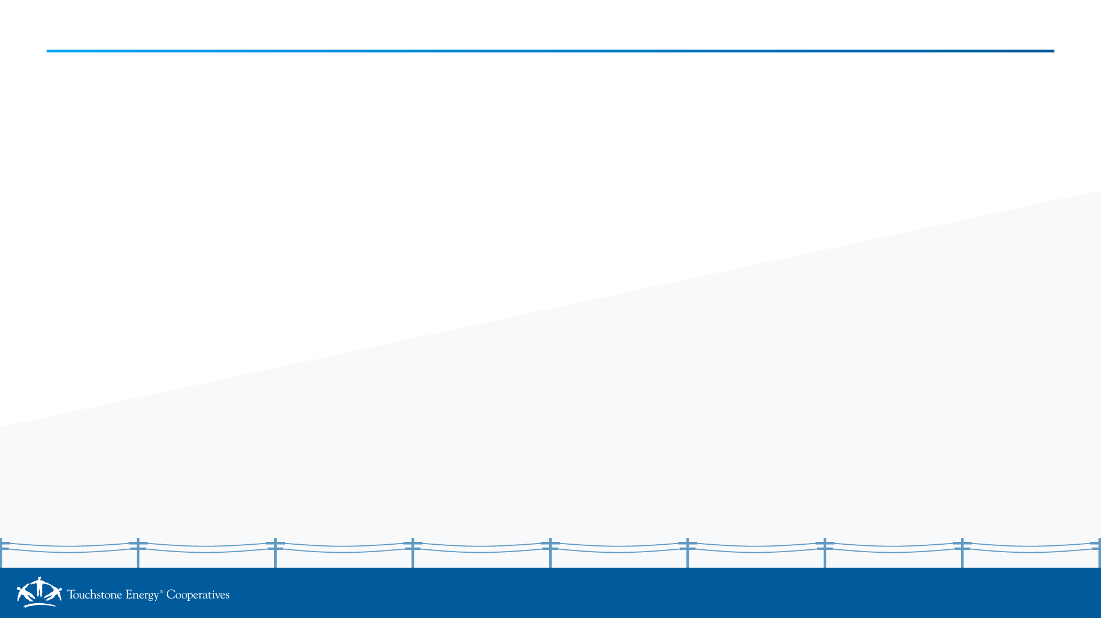
CURRENT COMMITTEE COMPOSITION
Position | Name | Cooperative | State | Start Date | End Date | Term Number
Chair | Eric Hawkins | Trico Electric | Arizona | 11/15/2022 | 11/15/2028 | 2
Member | Beau Baggett | Cumberland EMC | Tennessee | 7/24/2024 | 7/24/2027 | 1
Member | Terri Bakken | Minnesota Valley Electric | Minnesota | 3/9/2026 | 3/9/2029 | 1
Member | Dana Bolwerk | Dairyland Power Cooperative | Wisconsin | 3/9/2025 | 3/9/2028 | 1
Member | Emily Cowan | CHELCO | Florida | 7/23/2021 | 7/23/2027 | 2
Member | Matthew Hackman | Bartholomew County REMC | Indiana | 11/20/2020 | 11/20/2026 | 2
Member | Andrew Haggard | Mountain View Electric Assn. | Colorado | 3/9/2026 | 3/9/2029 | 1
Member | Lynn Hutchison | Tri-County Electric | Illinois | 3/9/2026 | 3/9/2029 | 1
Member | Heather Juzenas | The Energy Cooperative | Ohio | 3/3/2024 | 3/3/2027 | 1
Member | Brett Kinlaw | Lumbee River EMC | North Carolina | 11/5/2025 | 11/5/2028 | 1
Member | David Latona | DEMCO | Louisiana | 3/3/2024 | 3/3/2027 | 1
Member | Jason Lingle | Blue Ridge Energy | North Carolina | 3/9/2026 | 3/9/2029 | 1
Member | Seth Mitchell | GreyStone Power | Georgia | 3/9/2026 | 3/9/2029 | 1
Member | Stephanie Okuniewski | Pennsylvania REA | Pennsylvania | 7/23/2024 | 7/23/2027 | 1
Member | Mark Owen | South Central Power | Ohio | 3/9/2026 | 3/9/2029 | 1
Member | Ben Pierson | East River Electric | South Dakota | 6/29/2023 | 6/29/2029 | 2
Member | Kimberly Sanchez | Karnes Electric Cooperative | Texas | 3/9/2026 | 3/9/2029 | 1
Member | Rita Sanders | Grand Valley Power | Colorado | 6/29/2023 | 6/29/2029 | 2
Member | Brealee Villareal | United Cooperative Services | Texas | 3/9/2026 | 3/9/2029 | 1

Slide 3
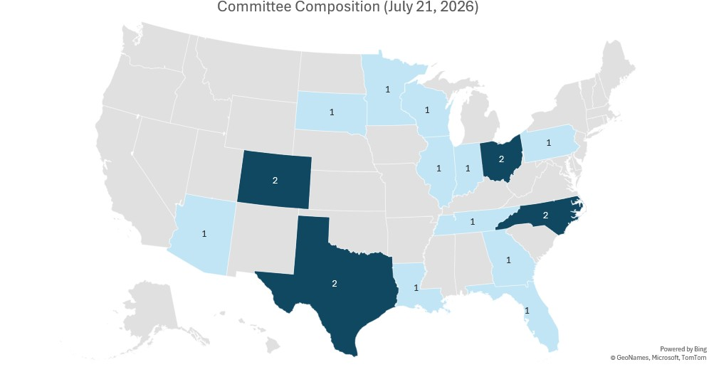
As of July 21, 2026, the Cooperative Performance & Research Committee has 19 members from
Distribution Cooperatives (16)
G&T (2)
Statewide (1)
Arizona (1) Colorado (2) Florida (1) Georgia (1) Illinois (1) Indiana (1) Louisiana (1) | North Carolina (2) Ohio (2) Pennsylvania (1) South Dakota (2) Tennessee (1) Texas (2) Wisconsin (1)

Slide 4
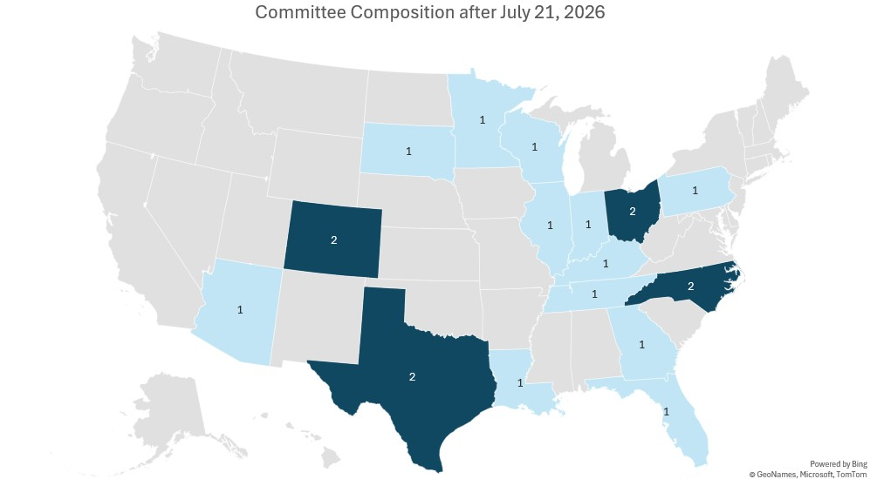
After July 21, 2026, the Cooperative Performance & Research Committee will have 20 members from
Distribution Cooperatives (17)
G&T (2)
Statewide (1)
Arizona (1) Colorado (2) Florida (1) Georgia (1) Illinois (1) Indiana (1) Kentucky (1) Louisiana (1) | North Carolina (2) Ohio (2) Pennsylvania (1) South Dakota (2) Tennessee (1) Texas (2) Wisconsin (1)

Slide 5
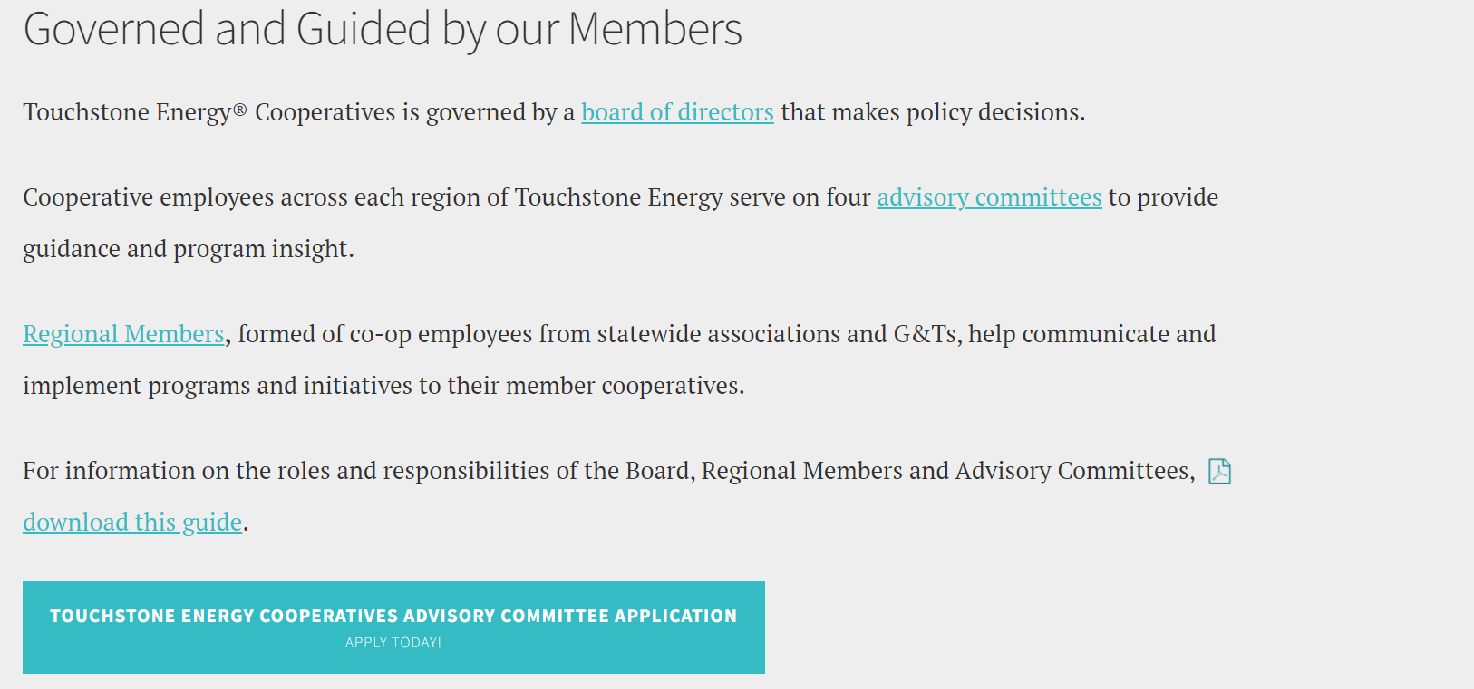
Committee Member Recruitment
If you know someone who might be a good fit for the Cooperative Performance & Research Committee and is interested in actively contributing to ongoing research efforts, please encourage them to submit an application.

Slide 6
Meetings
NEXT Conference
February 1-3, 2027
Amelia Island, FL
Power XChange
February 12-17, 2027
San Diego, CA
Connect
May 4-6, 2026
Columbus, OH
Cooperative Performance & Research Committee Meeting
October (Virtual)

