Slide 1

Published and Pending Studies

Slide 2

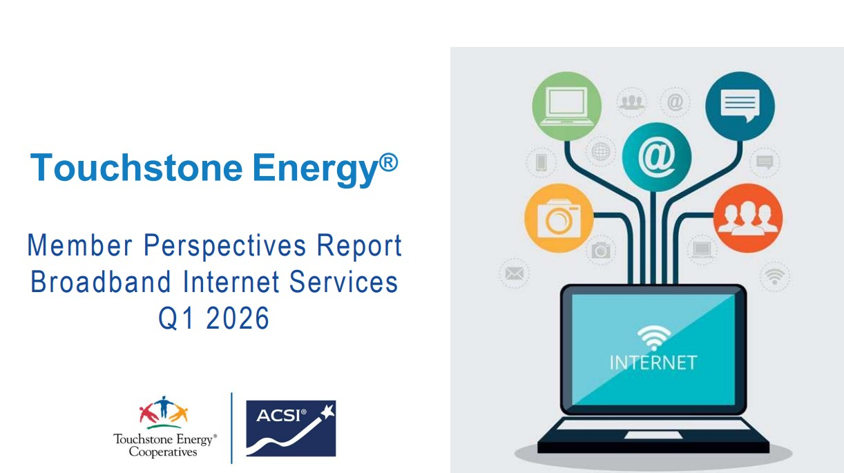

Published Studies
 | Overview of important facts and figures related to satisfaction among member-owners of Touchstone Energy cooperatives and the industry at large.
 | First Member Perspectives Report of 2026
 | Co-sponsored study published by the Smart Energy Consumer Collaborative (SECC)

Slide 3
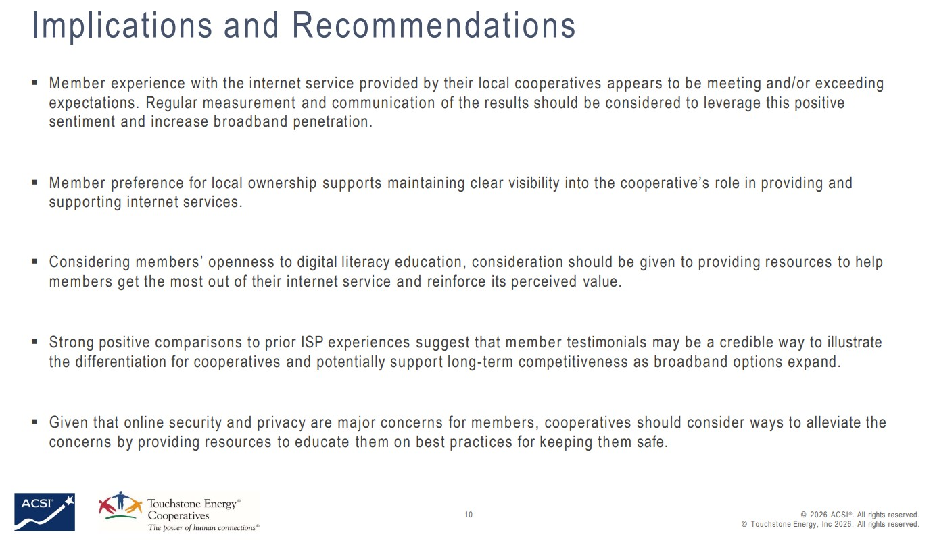
Published Studies: Broadband Internet Services
Conducted in April 2026, this qualitative research survey received feedback from 143 residential members from Continental Divide (NM), Coos-Curry Electric/Beacon Broadband (OR), Maquoketa Valley (IA), and Otsego Electric (NY).

Slide 4
Published Studies: Home Buying in the Energy Transition
Co-sponsored by Touchstone Energy and conducted in partnership with the National Association of REALTORS® in April 2026, this qualitative research survey explores the role that energy efficiency and clean energy technologies play in the home-buying process.
While consumers highly value energy efficiency, they rarely receive the information they need when evaluating homes. This engagement gap is an opportunity for electricity providers to empower real estate agent and build relationships with residential customers.

Slide 5
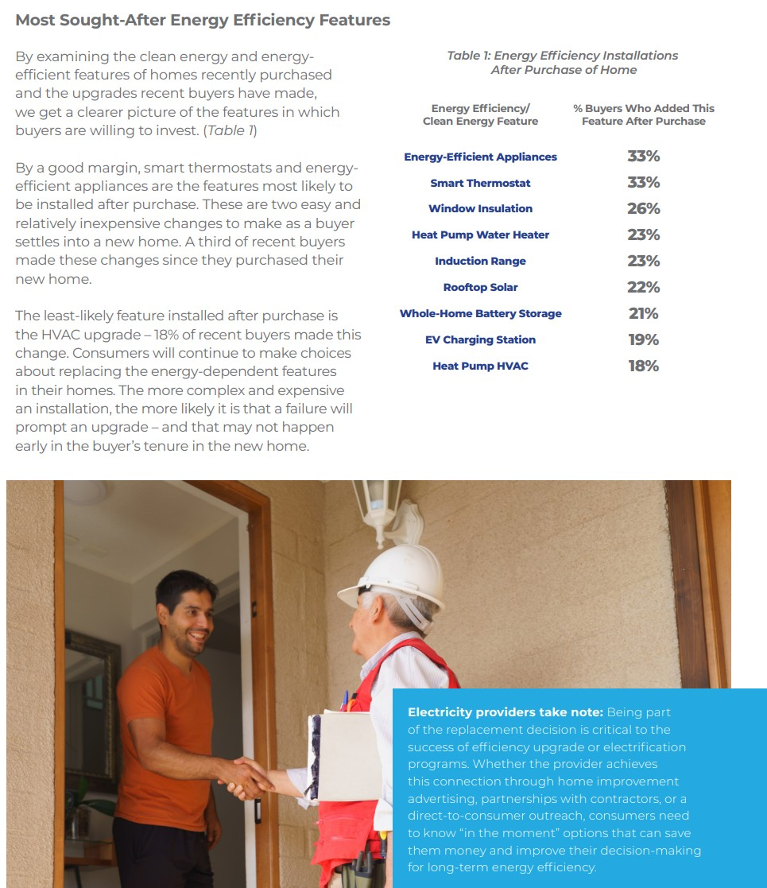
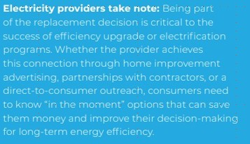

Slide 6
Pending Studies
Q3 | August | Gen Z
 | August | Exploring Energy Affordability
 | TBD | Cooperative Advantage Report
 | TBD | Community Engagement
Q4 | October | Analyzing Rate Choices: Implications for Consumer Behavior
 | TBD | Member Satisfaction and Engagement

