Slide 1


Touchstone Energy®
^{CPR Committee Session}
^{7/21/26}

Slide 2
Agenda
Review of the ACSI
Study Overview
National Cooperative Advantage Model Results
Key Drivers of Satisfaction
Notes:
Table of Contents

Slide 3
American Customer Satisfaction Index (ACSI®)
Notes:
Divider Slide

Slide 4
About the ACSI®
The American Customer Satisfaction Index (ACSI®) is the world’s leading authority on customer satisfaction
Developed in 1994 at the University of Michigan, the ACSI is based on technological advancements from a combination of econometrics, psychometrics and statistics for extracting cause-and-effect information from noisy customer survey data.
The American Customer Satisfaction Index (ACSI) is the only national cross-industry measure of customer satisfaction in the United States.
ACSI tracks roughly 400 companies in around 40 industries across ten economic sectors on an annual basis, the largest single benchmarking study in the U.S.
ACSI has been measuring satisfaction with the utility industry for more than 30 years

Slide 5
Understanding the ACSI® Syndicated Model
A cause-and-effect model based on multivariable components; what drives satisfaction and what is driven by satisfaction, and how strongly?
Drivers of satisfaction:
  Customer Expectations (what quality did I anticipate receiving?)
  Perceived Value (how good was the price relative to quality?)
  Perceived Quality (how strong was the quality overall?)
Satisfaction (ACSI) in the center
Outcomes of satisfaction:
  Customer Complaints (did customers voice dissatisfaction?)
  Customer Loyalty (will consumers stay with us?)

Slide 6
The Core ACSI® Model
Drivers
Outcomes
Overall
Customization
Reliability
Perceived
Overall Quality
Customer
Complaints
Customer
Satisfaction
(ACSI)
Perceived
Value
Complaint Behavior
Customer
Expectations
Price Given Quality
Quality Given Price
Customer
Loyalty
Satisfaction
Comparison w/ Ideal
Confirm/Disconfirm
Expectations
Overall
Customization
Reliability
Repurchase Likelihood
Price Tolerance
(Reservation Price)

Slide 7
Study Overview
Notes:
Divider Slide

Slide 8
Cooperative Advantage Methodology Overview
Survey results were collected from 04/27/2026 through 06/10/2026.
A total of 70 cooperatives participated in year 2 of the study.
  44 first time participants
  26 second year participants
To collect survey responses, participating cooperatives used one of two methods:
  1. Self-Distribution by Cooperatives (67 cooperatives):
  These cooperatives shared the ACSI survey link or QR code directly with their members using various outreach channels, including:
  - Email invitations
  - Bill inserts
  - Website links
  - Social media posts
  - Flyers at farmers markets
  - Other community-based methods
  2. ACSI Distribution (3 cooperatives):
  These cooperatives opted to have CFI Group send survey invitations via email, which included a direct link to the survey.
A total of 17,539 responses were collected.
Notes:
Overview/Survey Methodology

Slide 9

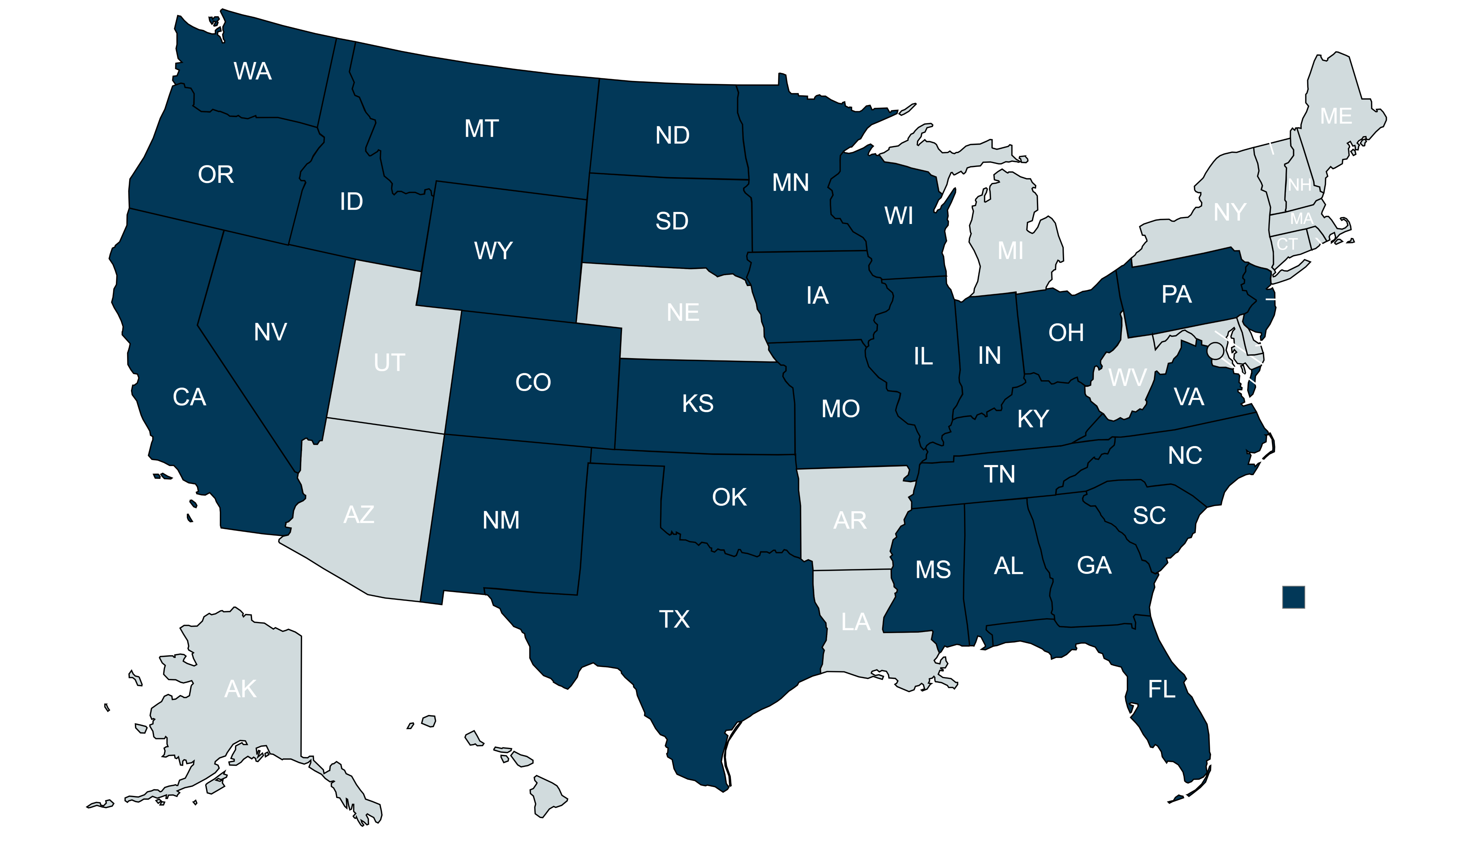
Regional and National Participation
Responses Received
A total of 70 cooperatives participated in 32 states across the country. Cooperatives from each of the four U.S. Census Bureau regions as follows:
Most participants reside in the South, totaling 7,628 responses. The fewest responses came from the Northeast with only 1,857 participants.
Some states drew more participating members than others: Texas posted 2,891 responses comprising 16% of the total sample. Georgia and Illinois account for 6% each, and Ohio respondents are 5% of the total in 2026.
On June 10th of 2026, the Study closed with 17,539 responses. The number of responses and geographic reach makes year 2 of the Cooperative Advantage Survey among the largest cooperative-exclusive satisfaction surveys in the country.
  Midwest = 25 (Illinois, Indiana, Iowa, Kansas, Minnesota, Missouri, North Dakota, Ohio, South Dakota, Wisconsin)
  Northeast = 4 (New Jersey, Pennsylvania)
  South = 31 (Alabama, Florida, Georgia, Kentucky, Mississippi, North Carolina, Oklahoma, South Carolina, Tennessee, Texas, Virginia)
  West = 10 (California, Colorado, Idaho, Montana, Nevada, New Mexico, Oregon, Washington and Wyoming)
Notes:
Overview/Survey Methodology

Slide 10
2026 National Cooperative Advantage ACSI Score
ACSI Benchmarks based on the
2026 ACSI Syndicated Study
Notes:
Table of Contents

Slide 11
ACSI Scores by Member Identity
Our findings suggest that members who identify themselves as members rather than customers report higher satisfaction levels. Why do you think that is?
ACSI:
Indicates score change is significant at 90% confidence
* Scores flagged where sample size < 30
Interpret results with caution

Slide 12
National Cooperative Advantage Model Results
Notes:
Divider Slide

Slide 13
Cooperative Advantage Model Scores, Industry Impacts
Satisfaction Drivers
85 | 1.8 | Outreach
86 | 1.8 | Call Center Satisfaction
91 | 1.6 | Service Reliability
89 | 1.5 | Website Satisfaction Index
93 | 0.9 | Billing and Payment
90 | 0.0 | Call Center Representatives
Future Behaviors
Likelihood to Recommend | 4.9 | 88
Likelihood to Speak Positively about Cooperative | 4.8 | 89
86
Overall Satisfaction: 89
Compared to Expectations: 84
Compared to Ideal: 85
n = 17,539
Likelihood to Choose Again | 4.6 | 87
Likelihood to Return to the Website | 1.9 | 92
Scores represent your performance as rated by customers.
Impacts show you which driver has the most/least leverage – where improvements matter most/least to your customers
Future behavior impacts show the expected change in respondent behavior for every five-point increase (or fraction thereof) in Satisfaction.
Notes:
Model Picture
Primary

Slide 14
Satisfaction Priority Matrix
Drivers in the Top Priority quadrant have a high impact on CSI and a relatively low score. These are the drivers where the organization can achieve significant improvements and see positive changes in customer satisfaction.
Strengths are high impact drivers that also have high scores. There is less room for improvement with these drivers than the Top Priorities, however, these drivers have high impact on satisfaction.
Maintain identifies high-scoring drivers that do not have high impact on customer satisfaction. Maintaining the already high scores for these drivers is important.
Secondary Opportunities are drivers that have low impact on satisfaction and are relatively low scoring.
Maintain
Strength
Secondary Opportunity
Top Priority

Slide 15
Key Drivers of Satisfaction
Notes:
Divider Slide

Slide 16

Outreach
Impact = 1.8
Outreach remains a top priority based on its high impact and relatively performance score which is unchanged at 85, an excellent score that still offers opportunity for improvement.
The area showing the most room for improvement is information provided on energy savings with a score of 82 in both 2025 and 2026.
Indicates change is significant at 90% confidence
* Scores flagged where sample size < 30
Interpret results with caution
Notes:
LVMV Scores – Current Period
Horizontal Bar

Slide 17
Call Center Satisfaction
Impact = 1.8
The Call Center Satisfaction Index remains unchanged compared to last year; member ratings suggest that call center experiences are falling short of member expectations.
The impact of this driver is high (1.8) among those customers who report having called the call center.
Indicates change is significant at 90% confidence
* Scores flagged where sample size < 30
Interpret results with caution
Notes:
LVMV Scores – Current Period
Horizontal Bar

Slide 18
Service Reliability
Impact = 1.6
Service Reliability remains a key strength with a relatively high impact and a stable performance score of 91.
Timeliness of power outage status updates provides the most opportunity for improvement despite the already excellent score of 87.
n= 17,503
Indicates change is significant at 90% confidence
* Scores flagged where sample size < 30
Interpret results with caution
Notes:
LVMV Scores – Current Period
Horizontal Bar

Slide 19
Website Satisfaction
Impact = 1.5
Members rate the website highly (89), and its continued strong performance makes it a meaningful driver of the overall ACSI score.
Indicates change is significant at 90% confidence
* Scores flagged where sample size < 30
Interpret results with caution
Notes:
LVMV Scores – Current Period
Horizontal Bar

Slide 20
Billing and Payments
Impact = 0.9
Cooperatives receive an exceptional score of 93 for Billing and Payments with the rating for the ease of understanding your bill receiving the lowest score at 91.
Indicates change is significant at 90% confidence
* Scores flagged where sample size < 30
Interpret results with caution
Notes:
LVMV Scores – Current Period
Horizontal Bar

Slide 21
Call Center Representatives
Impact = 0.0
While the relative impact is low, maintaining a high level of performance among the Call Center Representatives is necessary to keep member satisfaction from diminishing. With current performance scores remaining among the highest rates, the declines in 2026 should not be considered a major concern but rather something to continue to monitor going forward.
Indicates change is significant at 90% confidence
* Scores flagged where sample size < 30
Interpret results with caution
Notes:
LVMV Scores – Current Period
Horizontal Bar

